Slide 1
Adventures of .Net Core Microservices in the Kubernetes Universe

Slide 2


Slide 3


Slide 4


Slide 5


Slide 6


Slide 7


Slide 8
BUT THAT’S NOT WHAT WE CAME TO TALK ABOUT

Slide 9




Who am I
Juanjo Cerezuela
Lead Software Engineer @ Guestline
Shorinji Kempo instructor
Recently streaming code and videogames on twitch
@PliyoSan

Slide 10
Start with Why
Guestline is over 20 years old.
Leadership change, new equity.
Started a migration to the cloud with VMs and Azure WebApps
Thought about using more modern technologies
Created a maturity matrix, CI, CD, bonded context, events, ob-ser-va-bi-li-ty
We thought about adopting new technologies that will enable us to go faster. Think customers.

Slide 11

Where are we coming from

Slide 12
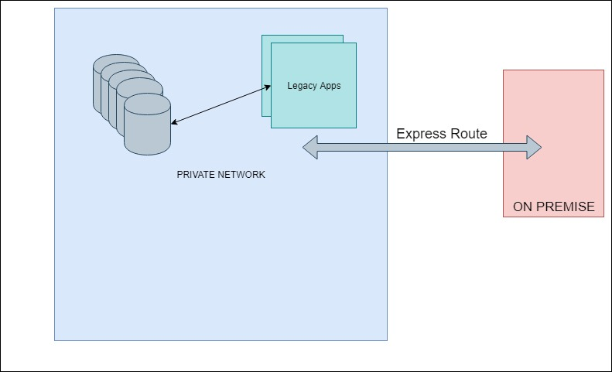
Where are we coming from

Slide 13
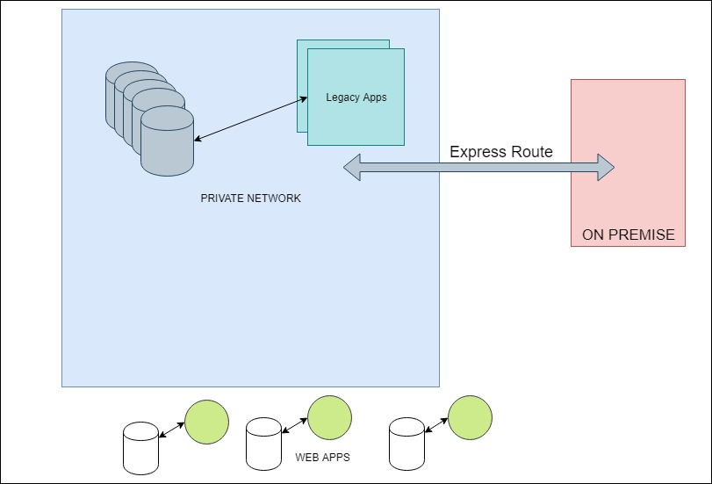
Where are we coming from

Slide 14
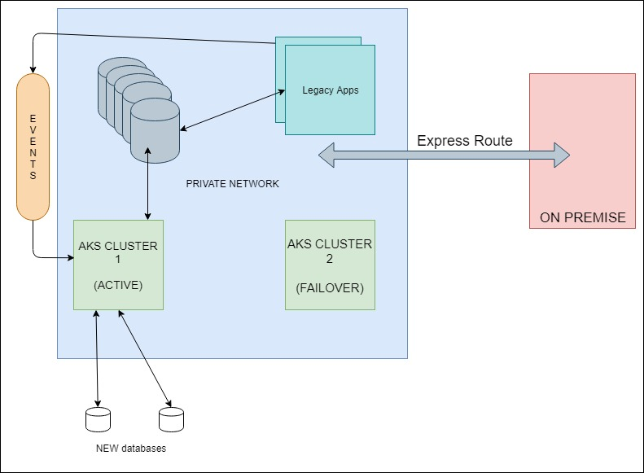
Where we are now

Slide 15
40+ apps living in Kubernetes

Slide 16
Why Kubernetes?
Containerize everything
Your deployment has a desired state, kubernetes takes care of you
Everything is pluggable like legos
Helm
Service Mesh
One central place for logging

Slide 17
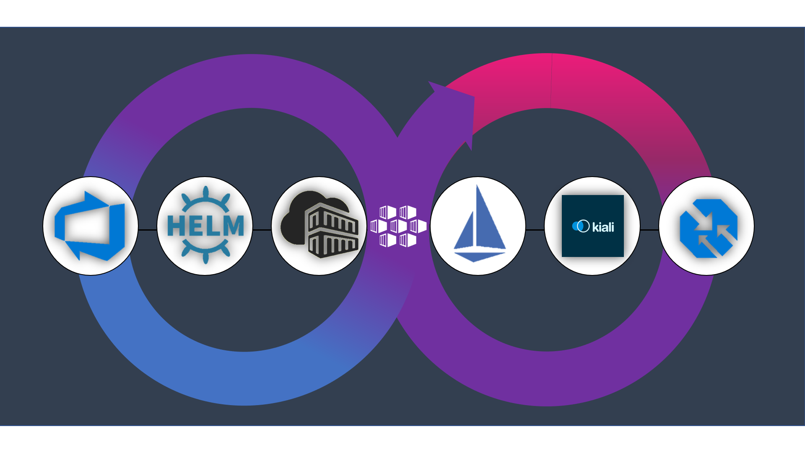
Raise the maturity of your ecosystem
Notes:
- This is the time to speak about our stack choices, and how helm is helping us organizing deployments, alongside Kiali and Istio. Why we chose a service mesh? And steps we have done in our journey for example automating certificates, automating deployments, building a common step to deploy, isolating teams for the burden of knowledge but giving them the basic hints.

Slide 18
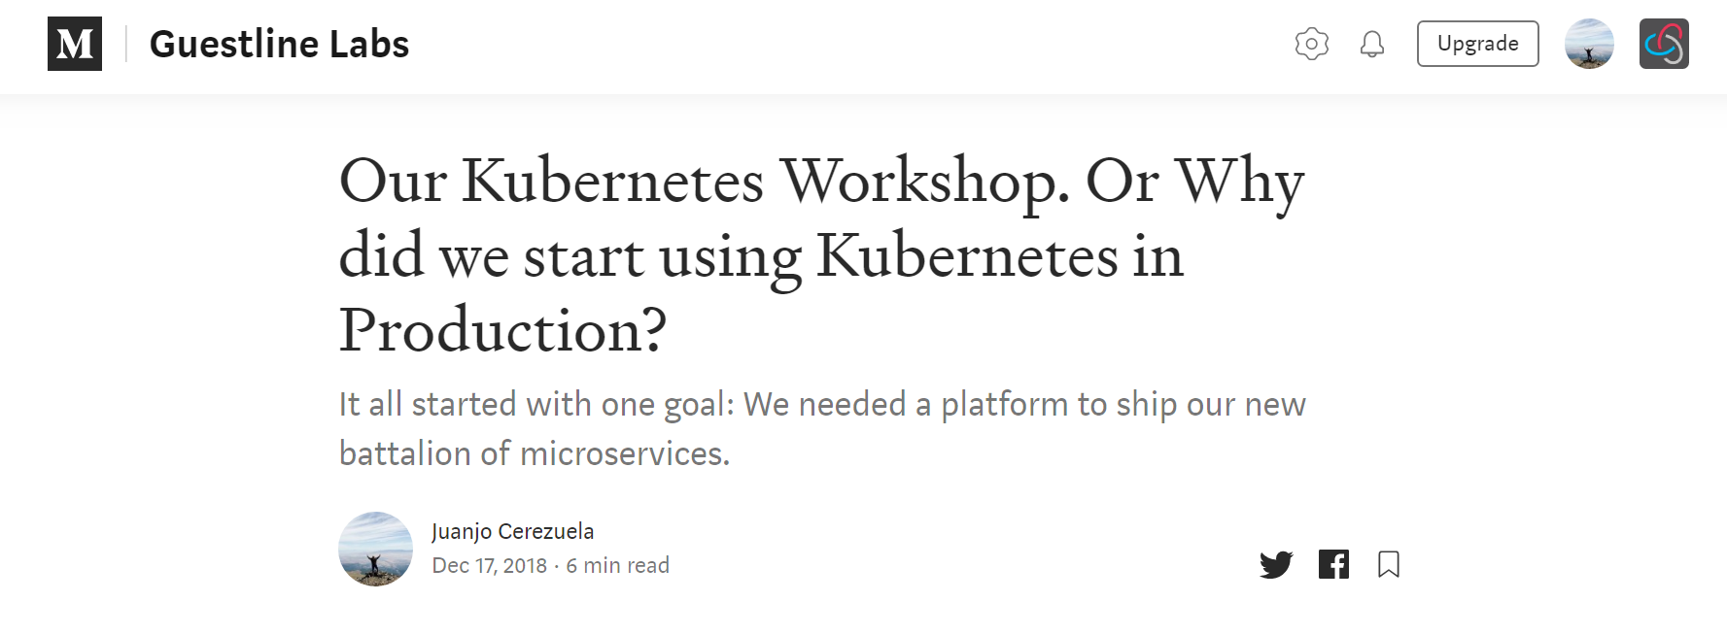

Slide 19
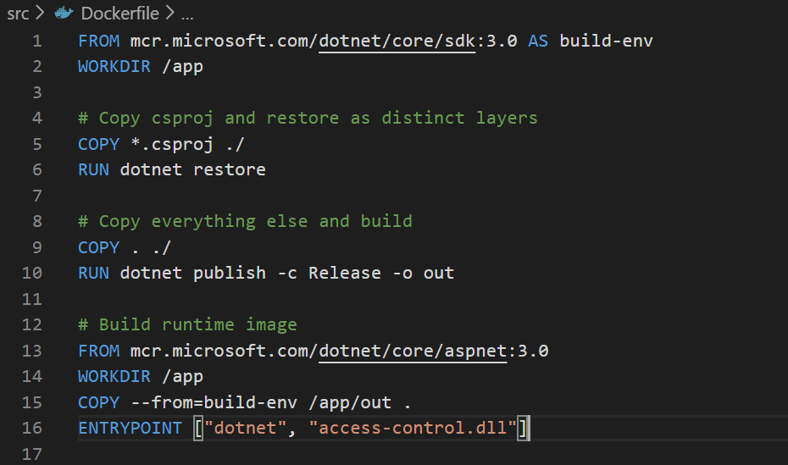
Step 1: Start with Containers

Slide 20
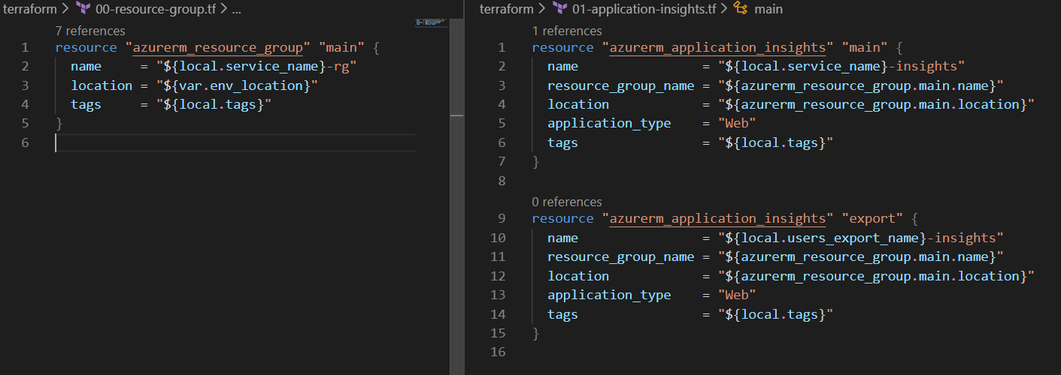
Step 2: Infrastructure automation

Slide 21
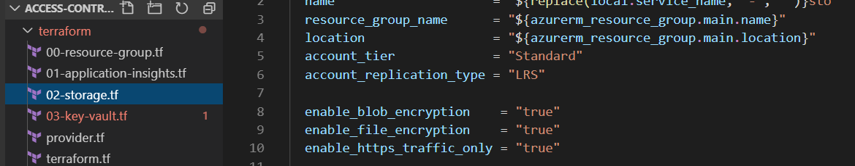
Step 2: Infrastructure automation

Slide 22
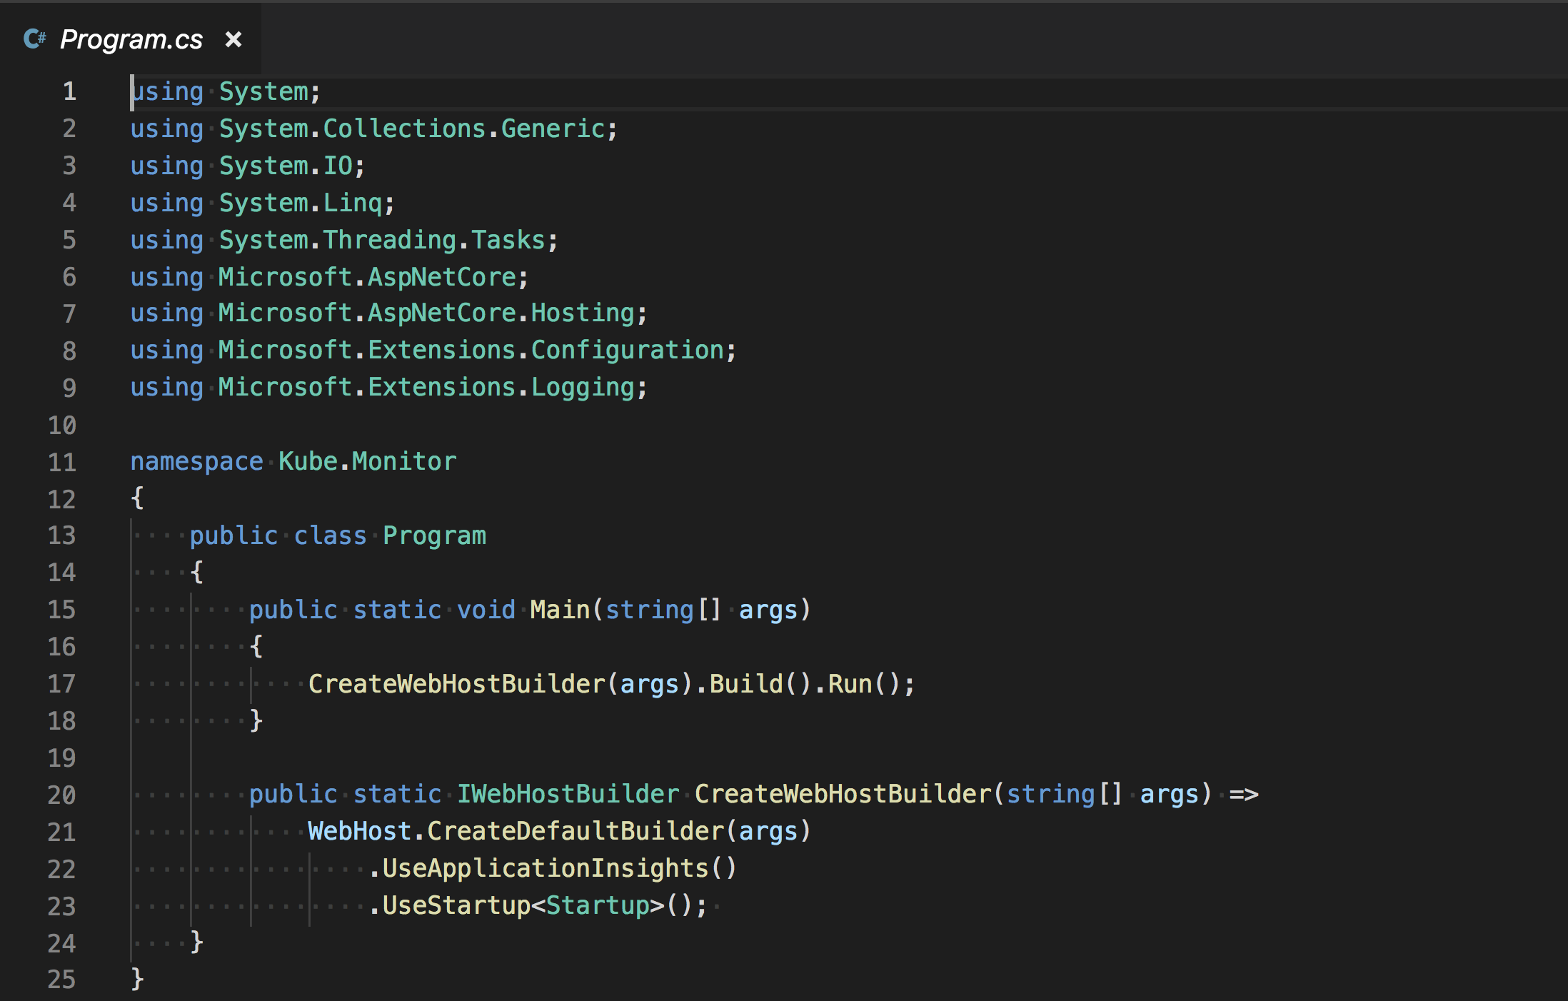
Step 3: Monitoring (.net Core 2.X)

Slide 23
Step 3: Monitoring (.net Core 3.0)

Slide 24
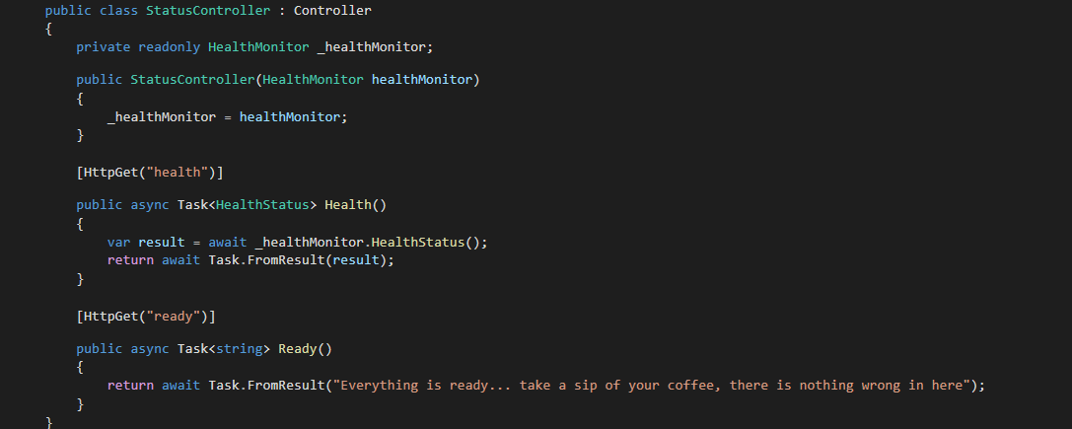
Step 4: Status Ready & Status Health

Slide 25
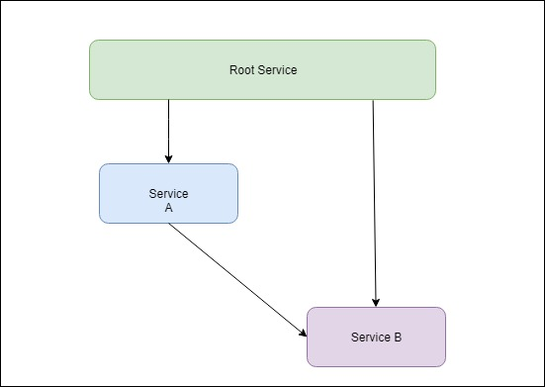
Step 4: Status Ready & Status Health

Slide 26
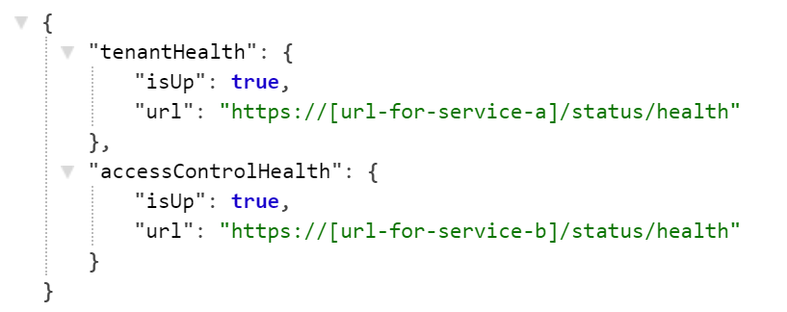
Step 4: Status Ready & Status Health

Slide 27
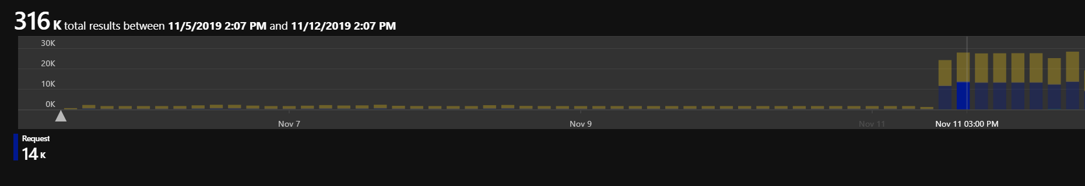
Step 4: Status Ready & Status Health

Slide 28
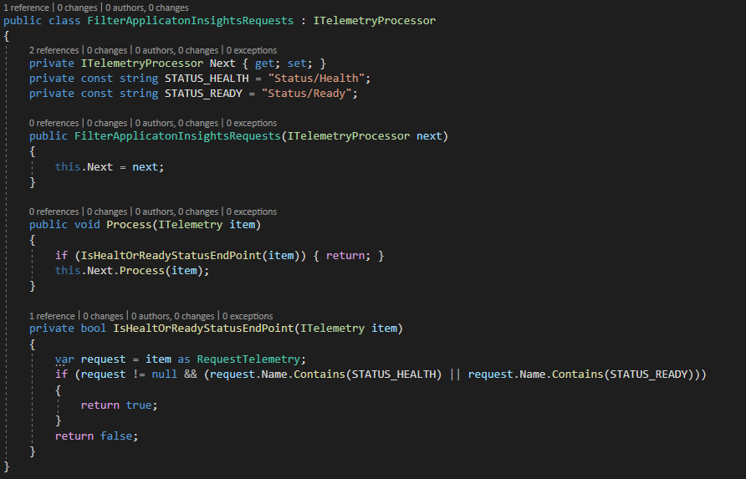
Step 5: App Insights Filtering (.Net 2.0)

Slide 29
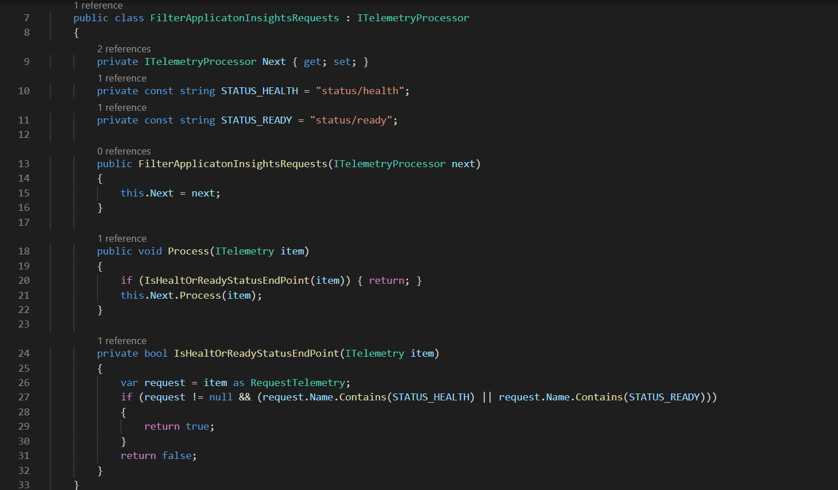

Slide 30
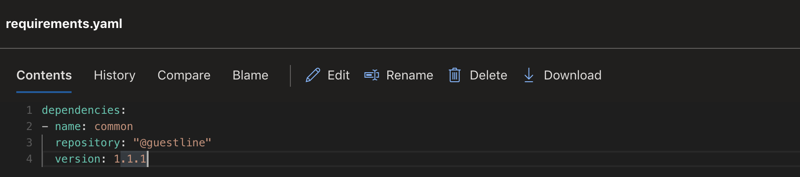
Step 6: Walking skeleton

Slide 31
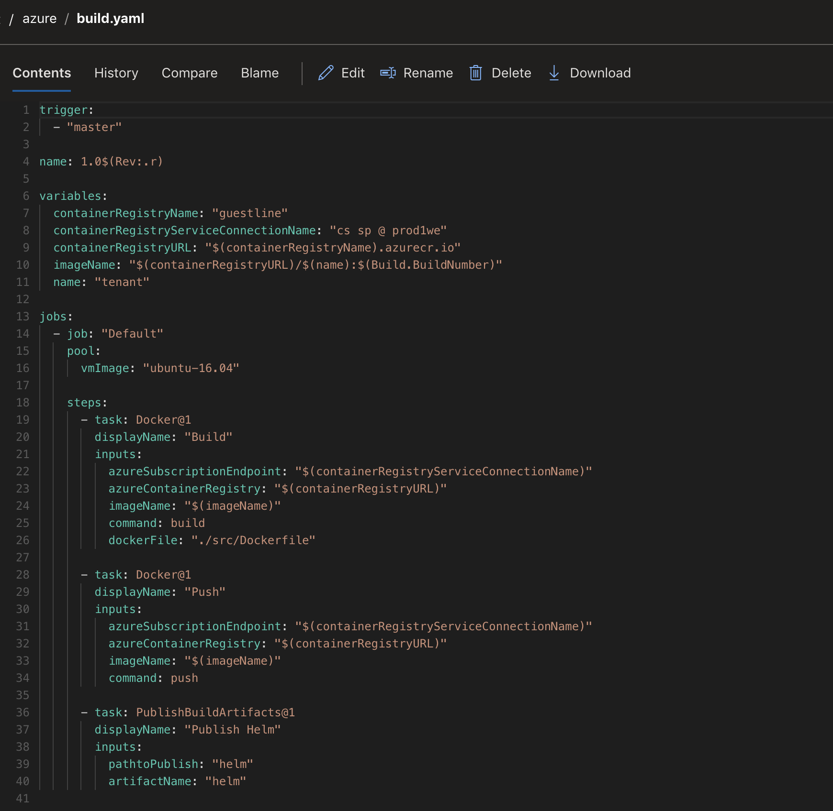
Step 7:
Pipeline
As
Code

Slide 32
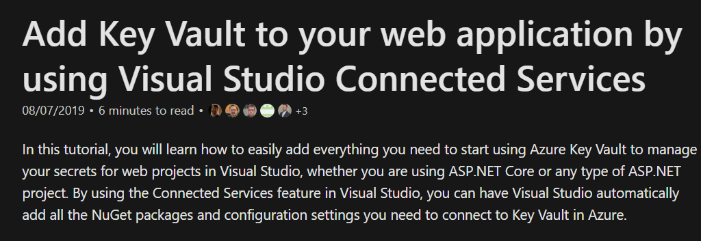

Step 8: Security

Slide 33

Step 8: Security
DON’T
SAVE
YOUR
SECRETS
IN
ENVIRONMENT
VARIABLES

Slide 34
Step 8: Security

Slide 35
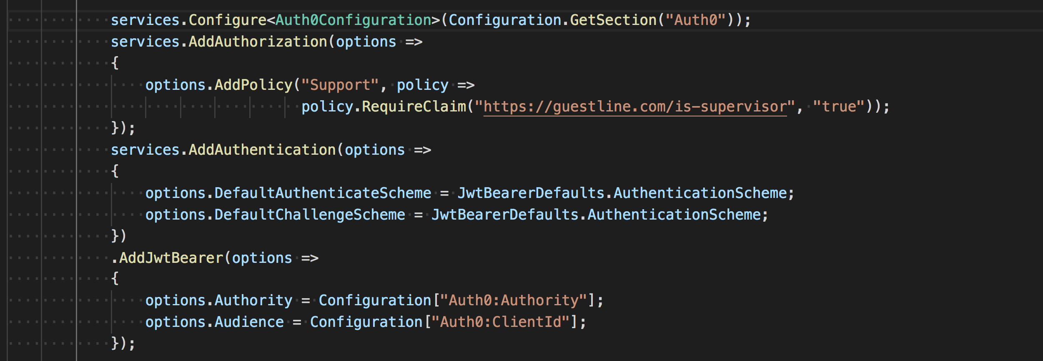
Step 9: Authorization & Authentication

Slide 36
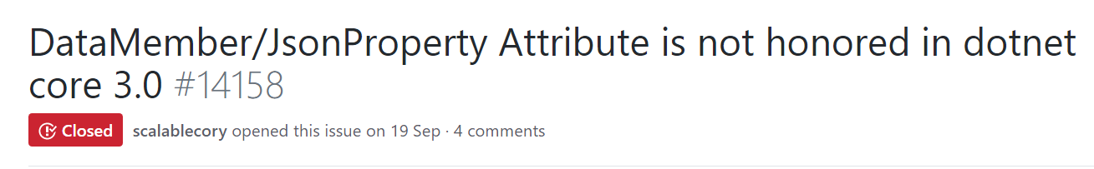

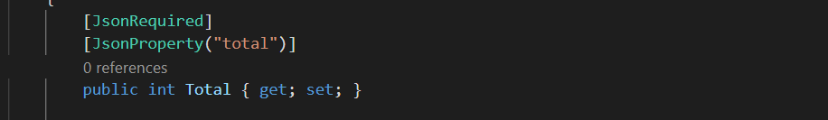
.Net Core 3.0 fun stories

Slide 37
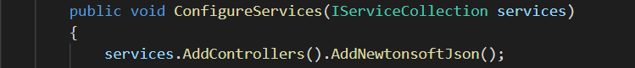
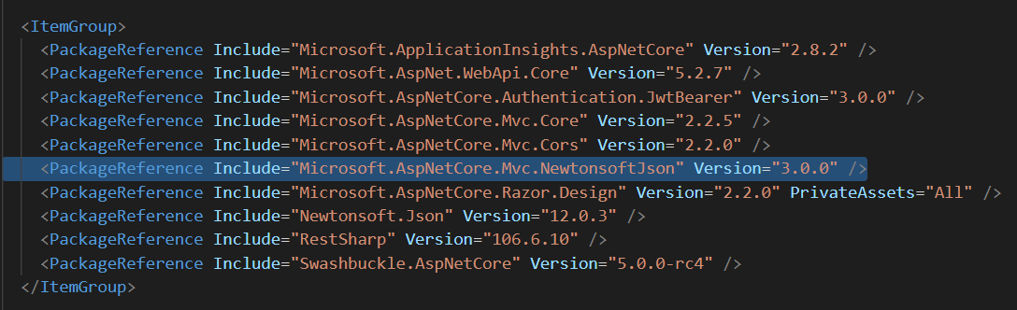
.Net Core 3.0 fun stories

Slide 38
Automate, learn, experiment

Slide 39


Slide 40


Slide 41


Slide 42
Thanks loves

